Slide 1
Applied Data Science Capstone
Matheus Pamato
May 22nd, 2024
https://github.com/MattPamato/Applied-Data-Science-Capstone.git+

Slide 2








•
•
•
•
•
•
2

Slide 3





























































































•
•
•
•
•
•
•
•
3

Slide 4













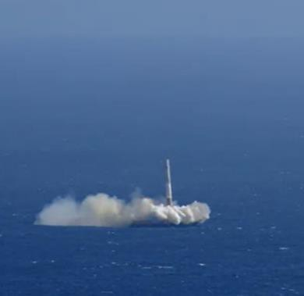
















































•
•
•
•
•
4

Slide 5






































•
•
•
•
•
•
•
•
5

Slide 6





































































6

Slide 7
Data Collection – SpaceXAPI
Request (Space X APIs)
.JSON file + Lists(Launch Site, Booster Version, Payload Data)
Json_normalize to DataFrame data from JSON
Dictionary relevant data
Cast dictionary to a DataFrame
Filter data to only include Falcon 9 launches
Replace missing PayloadMass values with mean

Slide 8
Data Collection – WebScraping
Request Wikipedia html
BeautifulSoup html5lib Parser
Find launch info html table
Cast dictionary to DataFrame
Iterate through table cells to extract data to dictionary
Create dictionary

Slide 9








































Data Wrangling

Slide 10















































EDA with Data Visualization

Slide 11































EDA with SQL

Slide 12


























Build an interactive map with Folium

Slide 13





Predictive analysis (Classification)

Slide 14

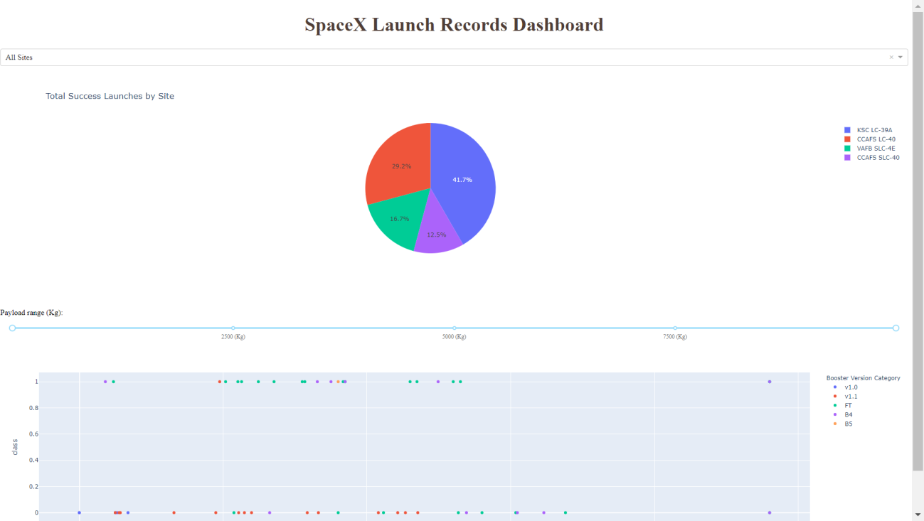
This is a preview of the Plotly dashboard. The following sides will show the results of EDA with visualization, EDA with SQL, Interactive Map with Folium, and finally the results of our model with about 83% accuracy.

Slide 15
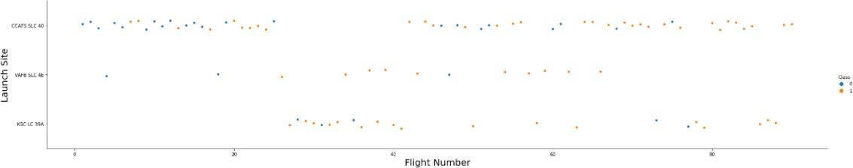
Flight Number vs. LaunchSite
Orangeindicates successful launch; Blue indicates unsuccessful launch.
Graphic suggests an increase in success rate over time (indicated in Flight Number). Likely a big breakthrough around flight 20 which significantly increased success rate. CCAFS appears to be the main launch site as it has the most volume.

Slide 16
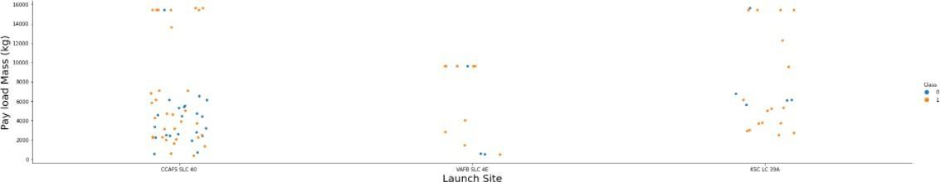
Payload vs. LaunchSite
Orange indicates successful launch; Blue indicates unsuccessful launch.
Payloadmass appears to fall mostly between 0-7000 kg. Different launch sites also seem to use different payloadmass.

Slide 17
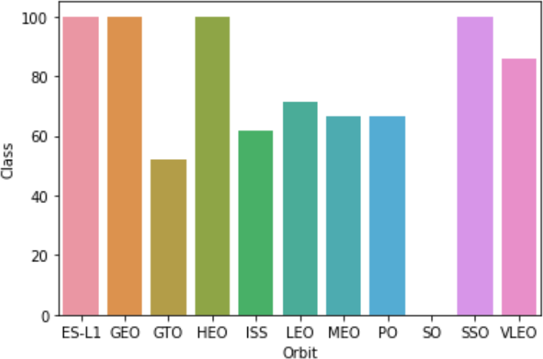
Successrate vs. Orbittype
Success Rate Scale with %
ES-L1 (1), GEO (1), HEO (1) have 100% success rate (sample sizes in parenthesis) SSO (5) has 100% success rate
VLEO (14) has decent success rate and attempts SO (1) has 0% success rate
GTO (27) has the around 50% success rate but largest sample

Slide 18
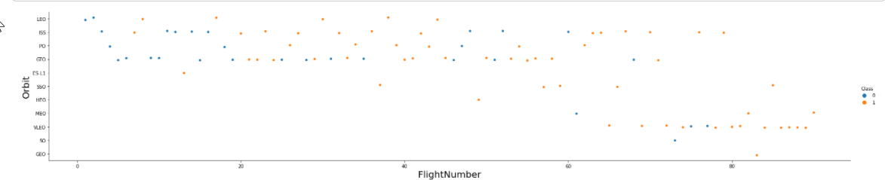
Flight Number vs. Orbittype
Orange indicates successful launch; Purpleindicates unsuccessful launch.
Launch Orbit preferences changed over Flight Number. Launch Outcome seems to correlatewith this preference.
SpaceX started with LEO orbits which saw moderate success LEO and returned to VLEO in recent launches
SpaceX appears to perform better in lower orbits or Sun-synchronous orbits

Slide 19
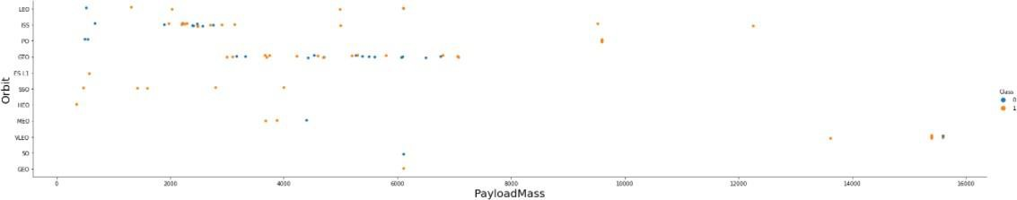
Payload vs. Orbit type
Orange indicates successful launch; Purpleindicates unsuccessful launch.
Payloadmass seems to correlatewith orbit
LEO and SSO seem to have relatively low payload mass
The other most successful orbit VLEO only has payload mass values in the higher end of the range

Slide 20
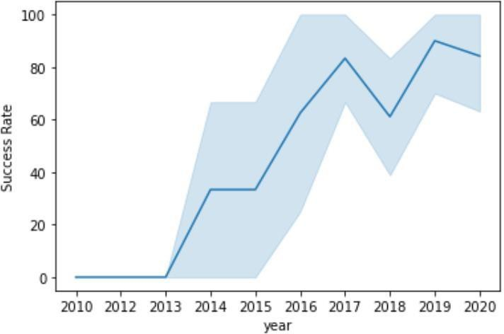
Launch SuccessYearlyTrend
95% confidence interval (light blue shading)
Success generally increases over time since 2013 with a slight dip in 2018 Success in recent years at around 80%

Slide 21
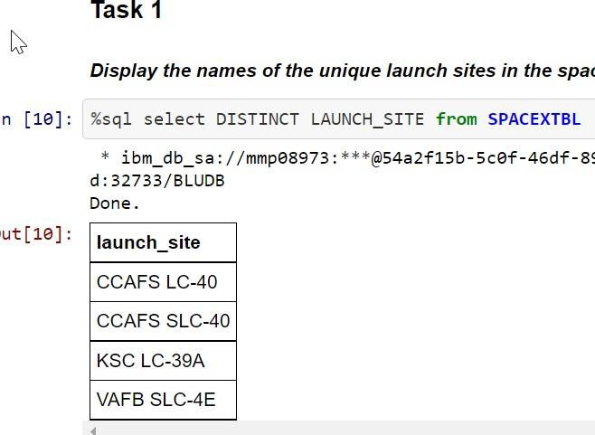
All Launch SiteNames
▶ Query unique launch site names from database.
▶ CCAFS SLC-40 and CCAFSSLC-40 likely all represent the same
▶ launch site with data entry errors.
▶ CCAFS LC-40 was
the previous name. Likely only
3 unique launch_site
25
values: CCAFS

Slide 22
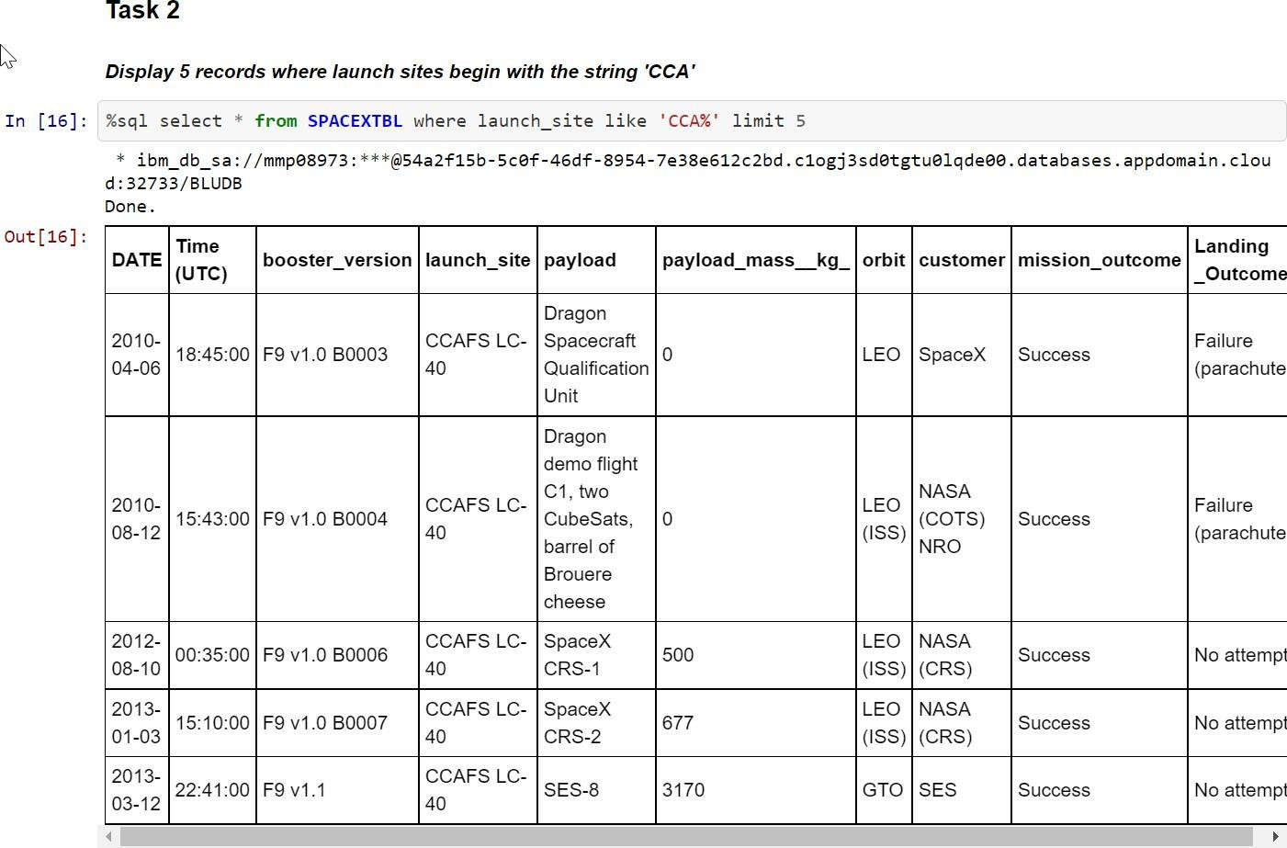
Launch Site NamesBeginning with `CCA`
First five entries in database with Launch Site name beginning with CCA.

Slide 23
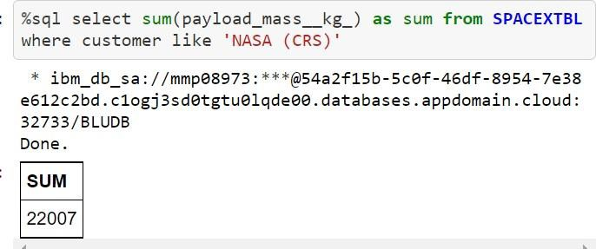
Total Payload Mass from NASA
This query sums the total payload mass in kg where NASA was the customer.
CRS stands for Commercial Resupply Services which indicates that these payloads were sent to the International Space Station (ISS).

Slide 24
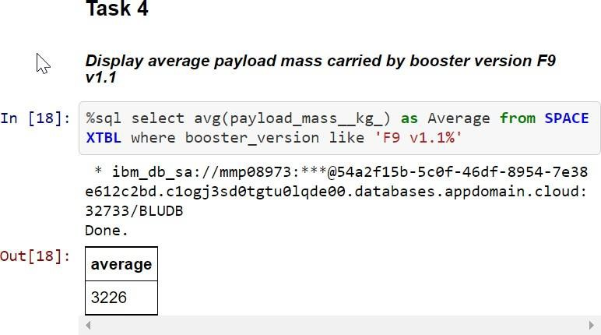
Average Payload Mass by F9v1.1
This query calculates the average payload mass or launches which used booster version F9 v1.1
Average payload mass of F9 1.1 is on the low endof our payload mass range

Slide 25
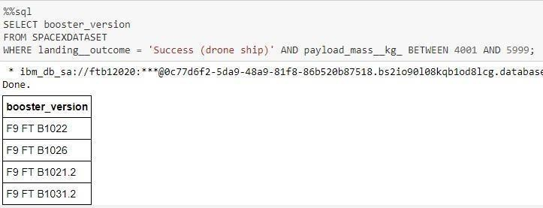
SuccessfulDrone Ship Landing with Payload Between 4000 and6000
This query returns the four booster versions that had successful drone ship landings and a payload mass between 4000 and 6000 noninclusively.

Slide 26
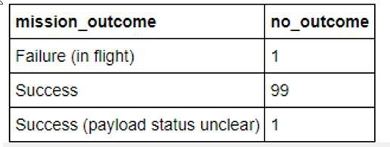
Total Number of EachMissionOutcome
This query returns a count ofeach
mission outcome.
SpaceX appears to achieve its mission outcome nearly 99% of the time.
This means that most of the landing
failures are intended.
Interestingly, one launch has an unclear payload status and unfortunately one failed in flight.

Slide 27
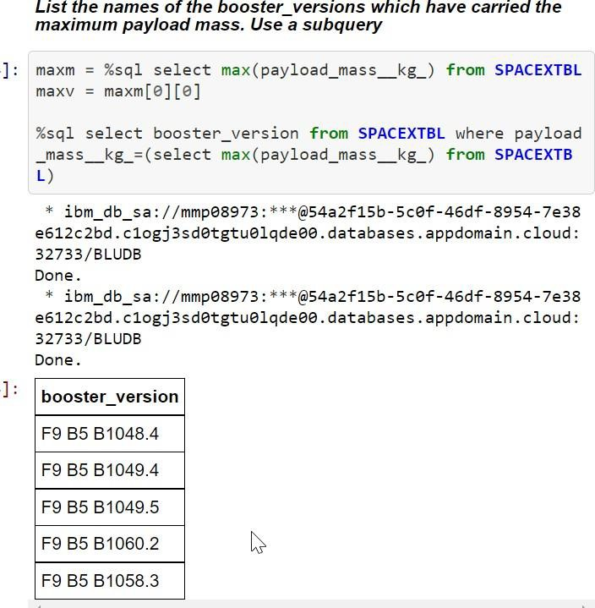
Boosters that Carried MaximumPayload
This query returns the booster versions that carried the highest payload mass of 15600 kg.
These booster versions are very similar and all are of the F9 B5 B10xx.xvariety.
This likely indicates payload mass correlates with the booster version that is used.

Slide 28
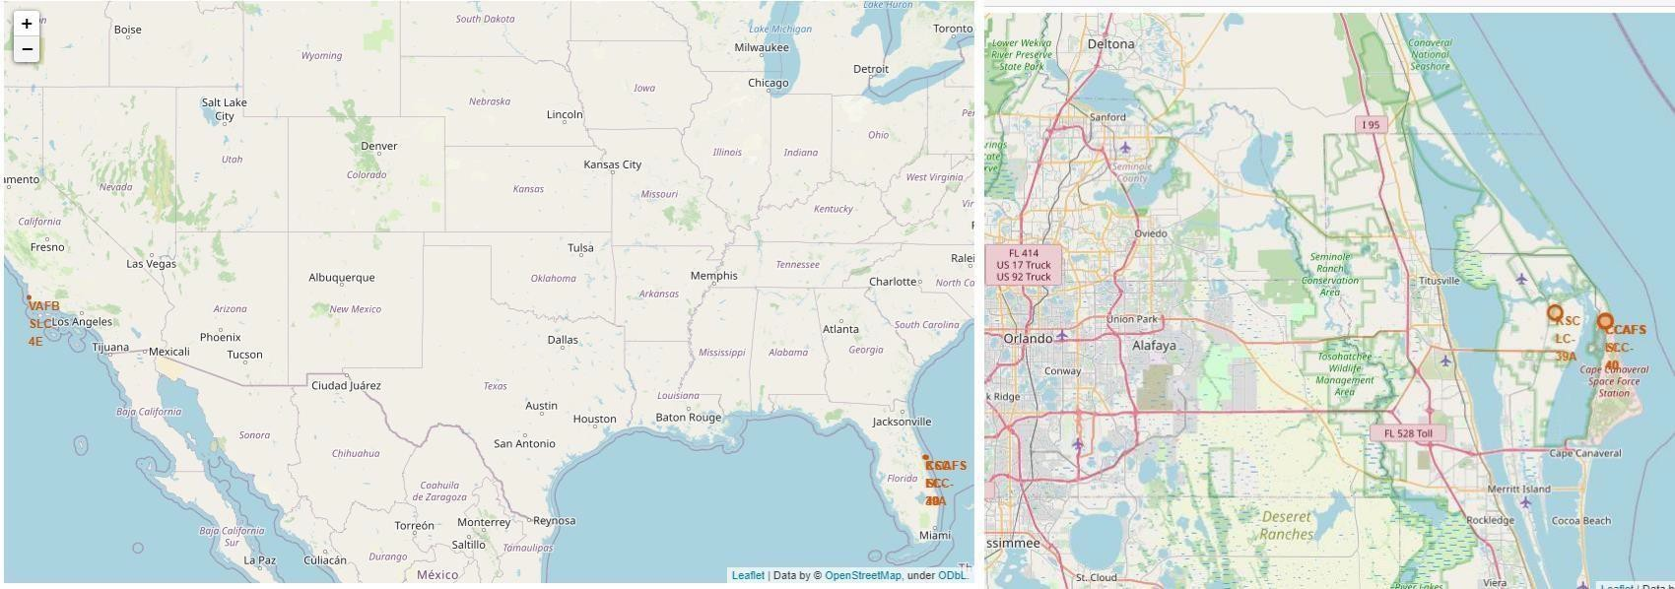
Launch Site Locations
The left map shows all launch sites relative US map. The right map shows the two Florida launch sites since they are very close to each other. All launch sites are near the ocean.

Slide 29
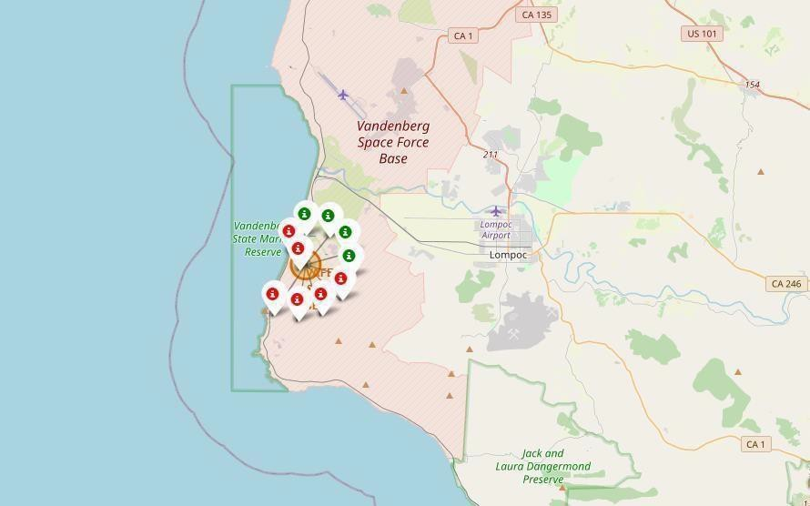
Color-Coded Launch Markers
Clusters on Folium map can be clicked on to display each successful landing (green icon) and failed landing (red icon). In this example VAFB SLC-4E shows 4 successful landings and 6 failed landings.

Slide 30
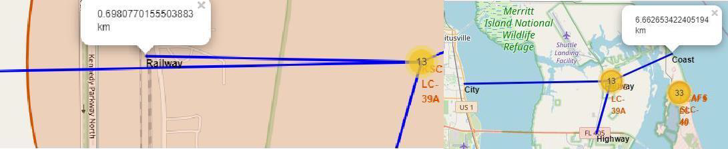
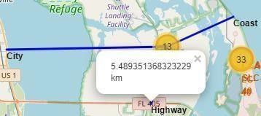
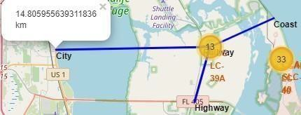
Key Location Proximities
Using KSC LC-39A as an example, launch sites are very close to railways for large part and supply transportation. Launch sites are close to highways for human and supply transport. Launch sites are also close to coasts and relatively far from cities so that launch failures can land in the sea to avoid rockets falling on densely populatedareas.

Slide 31
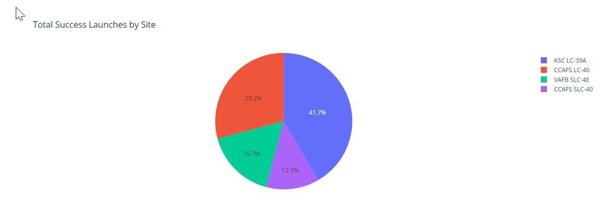

Successful LaunchesAcross Launch Sites
This is the distribution of successful landings across all launch sites. CCAFS LC-40 is the old name of CCAFS SLC-40 so CCAFS and KSC have the same amount of successful landings, but a majority of the successful landings where performed before the name change. VAFB has the smallest share of successful landings. This maybe due to smaller sample and increase in difficulty of launching in the westcoast.

Slide 32
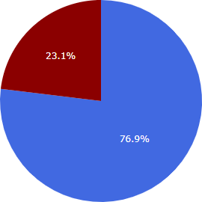

Highest SuccessRateLaunchSite
KSC LC-39A has the highest success rate with 10 successful landings and 3 failed landings.

Slide 33
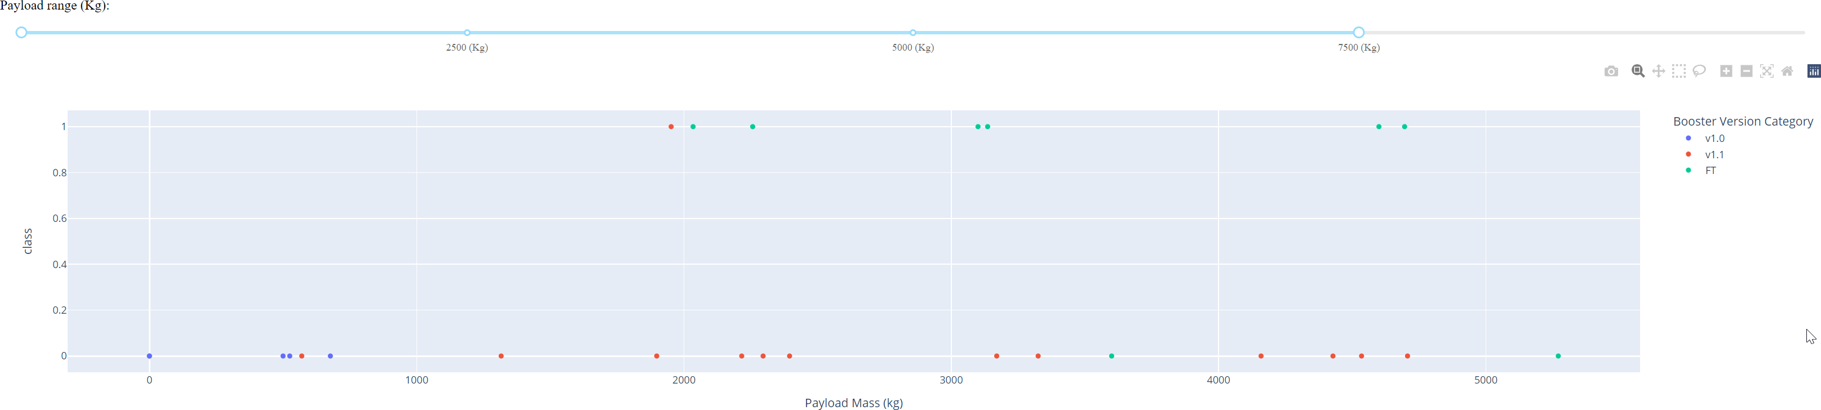
Payload Mass vs. Successvs. Booster Version Category
Plotly dashboard has a Payload range selector. However, this is set from 0-10000 instead of the max Payload of 15600. Class indicates 1 for successful landing and 0 for failure. Scatter plot also accounts for booster version category in color and number of launches in point size. In this particular range of 0-7500, interestingly there are two failed landings with payloads of zero kg.

Slide 34
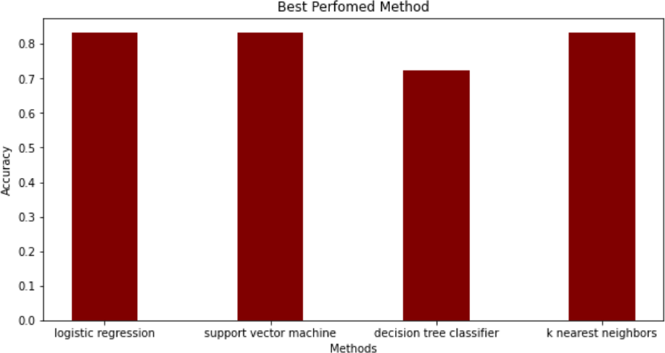
ClassificationAccuracy
The models had virtually the same accuracy on the test set at 83.33%accuracy, except the decision tree classifier with 72,23 %.
It should be noted that test size is small at only sample size of 18.
This can cause large variance in accuracyresults, such as those in Decision Tree Classifier model in repeated runs.
We likely need more data to determine the best model.

Slide 35
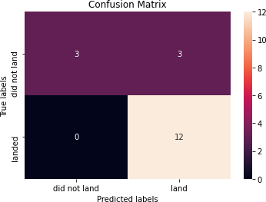
Confusion Matrix
Correct predictions are on a diagonal from top left to bottomright.
Since all models performed the same for the test set, the confusion matrix is the same across all models.
The models predicted 12 successful landings when the true label was successful landing.
The models predicted 3 unsuccessful landingswhen the true label was unsuccessful landing.
The models predicted 3 successful landings when the true label was unsuccessful landings (false positives).
42
Our models over predict successful landings.

Slide 36
CONCLUSION
Our task: to develop a machine learning model for Space Y who wants to bid against SpaceX
The goal of model is to predict when Stage 1 will successfully land to save ~$100 million USD
Used data from a public SpaceX API and web scraping SpaceX Wikipedia page
Createddata labels and stored data intoa DB2 SQL database
Created a dashboard for visualization
We createda machine learning model with an accuracy of 83%
Allon Mask of SpaceY can use this model to predict with relatively high accuracy whether a launch will have a successful Stage 1 landing beforelaunch to determine whether the launch should be made or not
More data should be collected to better determine the best machine learning model and
improve the accuracy

